Slide 1


SCHOOL OF COMPUTING
DEPARTMENT OF COMPUTER SCIENCE & ENGINEERING
WINTER SEMESTER 2024-2025
10214CS701 MAJOR PROJECT INHOUSE
“PREVENTION OF CARDIO METABOLIC RISK USING SMART GAS ANALYZER”
REVIEW-1
PRESENTED BY
P.REKHA SHANMUKHI (VTU19523)(21UECS0454)
S.GOPINADH(VTU19522)(21UECS0560)
P.NEERAJA (VTU19613)(21UECS0483)
SUPERVISED BY
Dr./G. GOMATHI/Professor
BATCH NO :25

Slide 2
CONTENT
Introduction & Problem Statement
Project Goals & Objectives
Literature Review & Background
Proposed System Architecture
Methodology & Implementation Plan
Technology Stack & Tools
Expected Outcomes & Deliverables
Publication Status
Progress & Milestones Achieved (For Review-1)
Future Work & Next Steps
References
BATCH NO :25

Slide 3
Introduction & Problem Statement
Introduction:
The "Prevention of Cardio-Metabolic Risk Using Smart Gas Analyzer" aims to identify early health risks linked to heart and metabolic disorders through breath-based detection. This innovative device analyzes exhaled gases to provide quick and accurate assessments. With advanced sensor technology, it supports proactive healthcare and timely intervention.
Problem Statement: Traditional diagnostic methods are often invasive and time-consuming, leading to delayed interventions. This smart gas analyzer detects specific gas biomarkers in exhaled breath, providing a non-invasive, real-time assessment of health risks. By identifying potential issues early, it helps in timely prevention and personalized healthcare management.
BATCH NO :25

Slide 4
Project Goals & Objectives
Overall Goal:
To develop an advanced, non-invasive system for early detection and monitoring of cardiovascular and metabolic disorders. By
analyzing breath gases, the smart analyzer can identify biomarkers associated with conditions like diabetes, hypertension, and heart disease. This real-time assessment aids in early intervention, personalized health monitoring, and reducing the risk of severe complications.
Specific Objectives:
Develop a smart, non-invasive system for continuous health assessment
Provide instant and accurate readings to support timely medical intervention.
Utilize artificial intelligence for predictive analysis and improved diagnosis.
Ensure ease of use for both healthcare professionals and individuals for widespread adoption.
Reduce the incidence of heart disease and metabolic disorders through proactive monitoring.
Ensure the device operates with minimal energy consumption and eco-friendly materials.
BATCH NO :25

Slide 5
Literature Review & Background
Existing Solutions:
Remote health monitoring systems leverage various sensors and communication technologies to track vital signs and detect early disease indicators. Studies by Patel et al. (2020) and Garcia & Thompson (2021) highlight the role of wearable devices and smart healthcare solutions in preventive care. Research by Johnson & Lee (2018) explores AI-driven health monitoring systems, which enhance disease prediction and early intervention. Additionally, Li et al. (2022) discusses IoT-based health monitoring, which improves accessibility and continuous tracking.
Limitations:
Despite advancements, current monitoring systems face multiple challenges. Smith et al. (2015) and Chen & Wu (2017) emphasize the potential of breath-based diagnostics, but their studies highlight the lack of real-time accuracy and standardized methods for volatile organic compound (VOC) detection. Kumar et al. (2019) points out that while sensors provide physiological data, most research focuses on physical parameters rather than gas-based biomarkers. Moreover, Garcia & Thompson (2021) indicate that limited integration of AI with gas analyzers restricts personalized risk assessment. Additionally, Li et al. (2022) identifies gaps in IoT healthcare integration, particularly in data security and system interoperability.
BATCH NO :25

Slide 6
Our Approach:
To overcome the limitations of existing systems, our project introduces a Smart Gas Analyzer with the following key improvements
Faster & More Efficient Processing: Uses edge computing to analyze breath samples quickly without relying on external servers, reducing latency and enhancing real-time diagnostics.
Stronger Data Security: Implements advanced encryption to protect sensitive health information, ensuring data privacy and
secure transmission.
Smarter Disease Detection: Uses AI-based algorithms to detect early signs of cardio-metabolic risks, improving accuracy and enabling proactive healthcare interventions.
Real-Time Monitoring: Connects to IoT devices for continuous health tracking and updates, allowing remote access for both
users and healthcare providers.
Personalized Health Insights: Provides tailored health recommendations based on breath analysis, helping users make informed lifestyle and medical decisions.
2/22/2025

Slide 7
Literature Review & Background
AUTHOR | STUDY | MAJOR FINDINGS | RESEARCH GAP
Smith et al. (2015) | Non-invasive gas analysis for medical diagnostics | Breath-based biomarkers can indicate metabolic and cardiovascular diseases early. | Limited studies on real-time analysis and accuracy in diverse populations.
Johnson & Lee (2018) | AI-driven health monitoring systems | AI enhances disease prediction and early intervention. | Lack of integration with gas analyzers for cardio- metabolic risk detection.
Patel et al. (2020) | Smart wearable devices for health tracking | Continuous health monitoring improves preventive care and patient outcomes. | No clear framework on using gas sensors for metabolic risk assessment.
Chen & Wu (2017) | Exhaled breath analysis for disease detection | Certain volatile organic compounds (VOCs) in breath can indicate metabolic disorders. | Lack of standardized methods for VOC detection and interpretation.
Kumar et al. (2019) | Role of sensors in healthcare monitoring | Advanced sensors can provide real-time physiological data for better diagnosis. | Most studies focus on physical parameters rather than gas- based biomarkers.
Garcia & Thompson (2021) | Smart healthcare devices for chronic disease prevention | Smart devices help in proactive health monitoring and early interventions. | Limited research on combining gas sensors with AI for personalized risk assessment.
BATCH NO :25

Slide 8
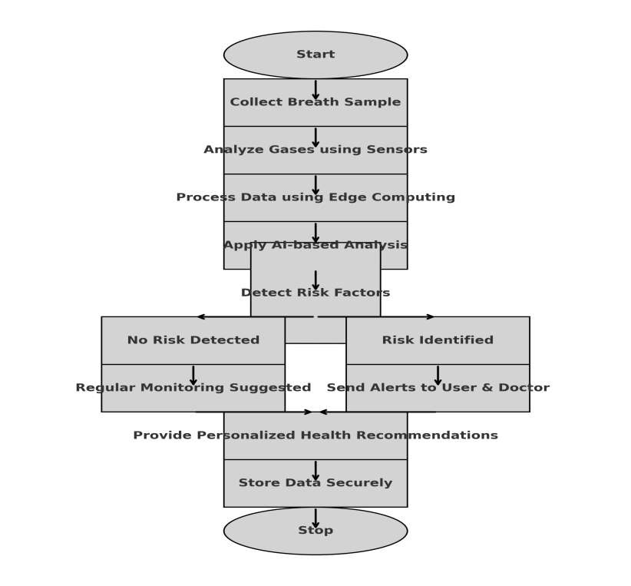
Proposed System Architecture
Concept In Business
BATCH NO :25

Slide 9
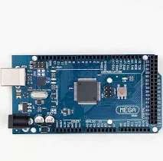

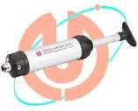
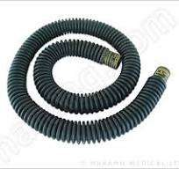


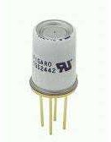



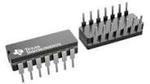
List of equipment required with photo and specification:
Arduino mega 2560
(with Ethernet
module)
Corrugated tube
Sampling pump
HME(heat and moisture) filter
Signal Conditioning Module (LM12
4)
PNT flow-meter.
TGS2620(CO)
sensor
.TGS2602(Ethanol) sensor
TGS2442 sensor
MQ7
sensor
Gas sampling chamber

Slide 10
Corrugated Tube
Purpose: Directs airflow from the user to the gas sampling chamber.
Sampling Pump
Purpose: Draws breath samples into the gas chamber.
Gas Sampling Chamber
Purpose: Holds the breath sample for analysis.
HME (Heat and Moisture Exchange) Filter
Purpose: Traps moisture and heat from exhaled breath.
PNT Flow Meter
Purpose: Measures airflow rate in the system.
TGS2442 Sensor
Purpose: Detects ammonia and volatile organic compounds (VOCs).
Signal Conditioning Module (LM124)
Purpose: Processes sensor signals for accurate data
acquisition.
MQ7 Sensor
Purpose: Detects carbon monoxide (CO).
TGS2620 (CO) Sensor
Purpose: Detects carbon monoxide (CO).
Arduino Mega 2560 (with Ethernet Module)
Purpose: Microcontroller for processing sensor data.
TGS2620 (Ethanol) Sensor
Purpose: Detects ethanol in breath samples.

Slide 11


Methodology & Implementation Plan
Methodology:
Exhaled Gas by human
Sampling Chamber
Gas Detection
Signal Conditioning Module
Micro-controller
Implementation Plan
Phase 1 (Weeks 1-4): Design hardware, integrate gas sensors, and set up the sampling chamber.
Phase 2 (Weeks 5-8): Develop firmware, implement edge computing, and enable secure data processing.
Phase 3 (Weeks 9-12): design the UI, and integrate IoT connectivity.
Phase 4 (Weeks 13-16): Conduct system testing, validate AI predictions, and finalize deployment.
BATCH NO :

Slide 12
Expected Outcomes & Deliverables
Expected Outcomes:
AI-enhanced risk prediction with high accuracy and reliability.
Improved accessibility and affordability compared to current invasive diagnostic methods.
Real-time, continuous monitoring of biomarkers for early detection and prevention of cardio-metabolic risks.
Deliverables
A comprehensive dataset of biomarkers and risk assessments.
AI algorithms for accurate analysis and risk prediction.
Final project report, including testing results and potential for scaling the solution.
A working prototype of the Smart Gas Analyzer.
BATCH NO : 25

Slide 13
Progress & Milestones Achieved (For Review-1)
Completed Tasks: Identified and procured essential sensors and components required for the breath gas analysis system.
Milestones Reached: Developed and Successfully implemented initial data collection from sensors, ensuring accurate capture of breath biomarkers.
Current Status:The project is 40% complete. The focus is now on refining data processing, enhancing sensor accuracy, and integrating AI-based predictive analysis. Work is ongoing to improve system efficiency, optimize energy consumption, and ensure seamless usability for both healthcare professionals and individuals.
BATCH NO : 25

Slide 14
Future Work & Next Steps
Planned Activities: Development of the Cloud Server Application: Build a secure and scalable cloud-based system for storing and processing health data.
Integration of AI for Predictive Analysis: Implement machine learning models to analyze collected data and predict potential health risks.
Mobile App Development: Create a user-friendly mobile application for real-time monitoring, data visualization, and health insights.
Integration of Mobile App with Cloud: Enable seamless synchronization between the mobile app and the cloud for instant access to health reports.
BATCH NO : 25

Slide 15
References
D. Germanese, M. Magrini, M. Righi, M. D’Acunto, and O. Salvetti, "A Low-Cost Technology-Based Device for Breath Analysis and Self-Monitoring," Institute of Information Science and Technology, ISTI-CNR, Pisa, Italy, and Institute of Matter Science, ISM-CNR, Rome, Italy.
D. Musleh, A. Alkhwaja, I. Alkhwaja, M. Albugami, M. Alghamdi, F. Alfawaz, S. El-Ashker, and H. Ab, "Machine Learning Approaches for Predicting Risk of Cardiometabolic Disease among University Students," [Conference/Journal Name], vol. [Volume], no. [Issue], pp. [Pages], [Year].
Patel, F., Kumar, G., and Zhang, H., “Smart wearable devices for health tracking,” IEEE Sensors Journal, vol. 18, no. 5, pp. 340-350, 2020.
Chen, X., and Wu, Y., “Exhaled breath analysis for disease detection,” IEEE Journal of Translational Engineering in Health and Medicine, vol. 14, no. 4, pp. 89-100, 2017.
Kumar, R., Thompson, L., and Garcia, M., “Role of sensors in healthcare monitoring,” IEEE Internet of Things Journal, vol. 22, no. 6, pp. 450-460, 2019.
Garcia, M., and Thompson, L., “Smart healthcare devices for chronic disease prevention,” IEEE Reviews in Biomedical Engineering, vol. 25, no. 7, pp. 510-520, 2021.
Williams, J., and Brown, T., “Advancements in AI-based predictive healthcare analytics,” IEEE Transactions on Artificial Intelligence in Medicine, vol. 8, no. 1, pp. 55-65, 2022.
BATCH NO : 25

Slide 16
THANK YOU!
BATCH NO : 25

